Slide 1
Connections on Differentiable Manifolds
Martin Šimák

Slide 2
Why is differential geometry important?
It provides an elegant approach to both differential and integral calculus on general geometries.
Aims of the thesis are to:
explain the basic concepts of differential geometry;
show equivalence of connections and covariant derivatives.

Slide 3
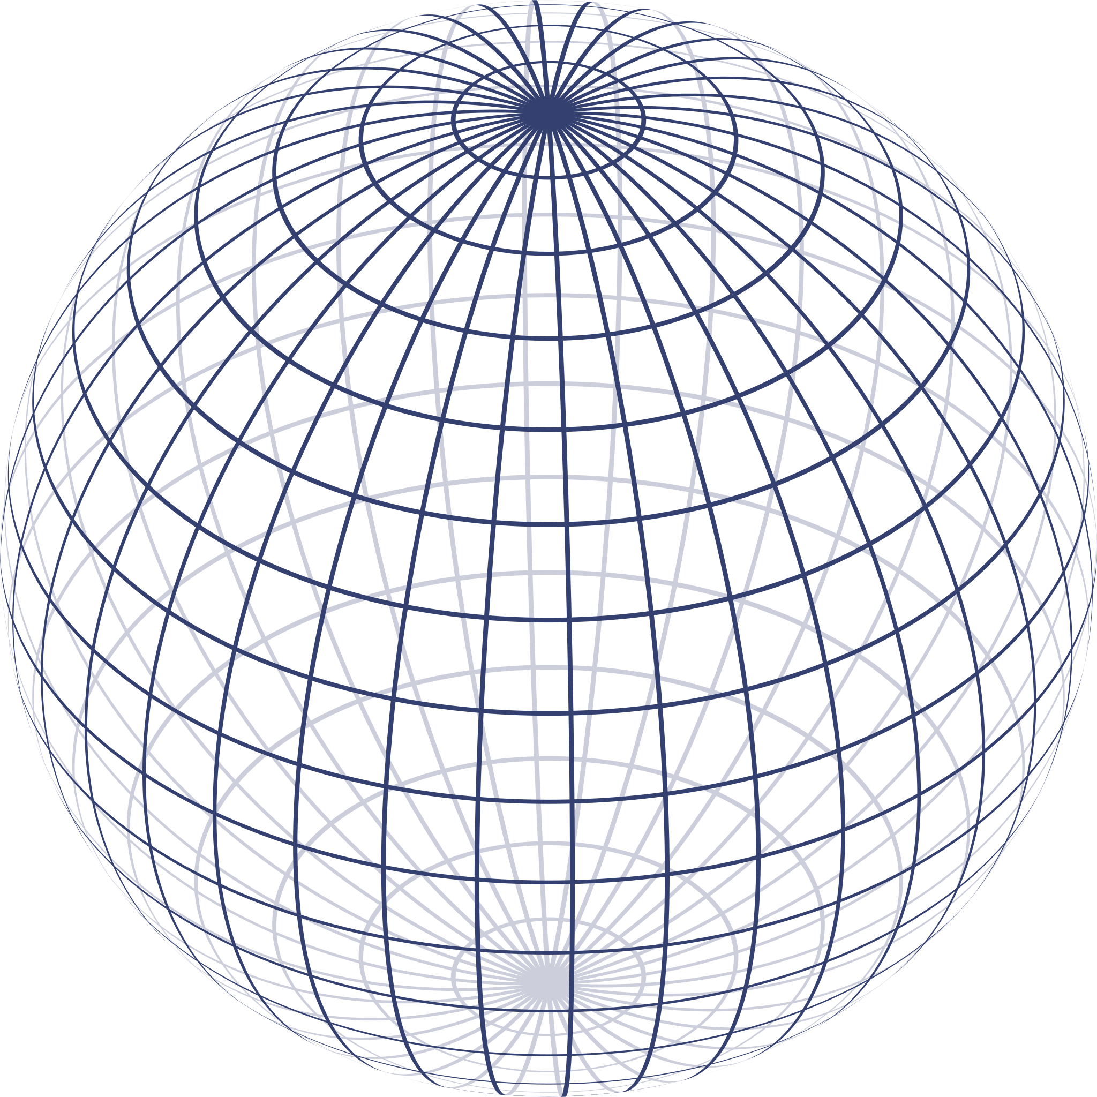
What is a smooth manifold?
Smooth manifold is a generalised geometrical object which retains the “nice properties” of Euclidean spaces, which we utilise in the definitions of differential calculus, locally.
Picture courtesy of user Geek3 at Wikipedia Commons

Slide 4
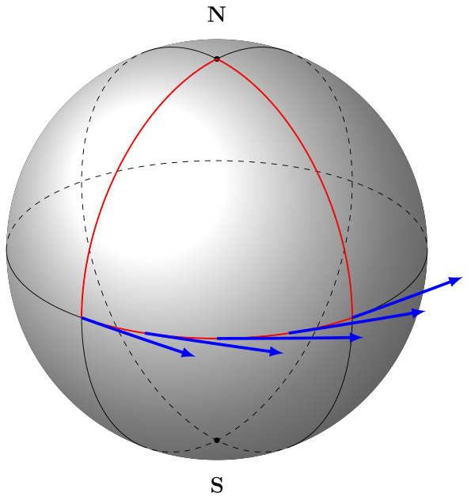
How to find out that a tangent vector stays the same?
The vector does not change its direction and magnitude.
This approach leads to some form of a derivative—Covariant derivative.
2. The vector stays the same in nearby places.
This approach leads to a connection of
tangent spaces—Connection on tangent
bundle.
The image has been created using TikZ macros by Till Tantau.

Slide 5
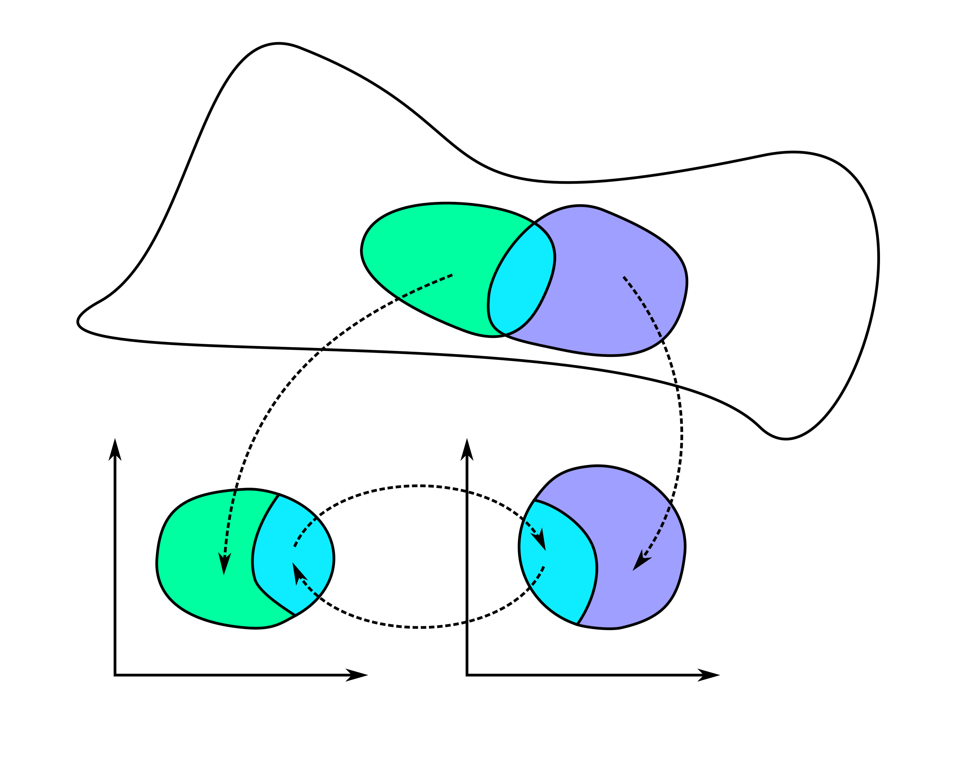

How to describe a smooth manifold?
Smooth manifolds are “isomorphic” to an $n$-dimensional Euclidean space on separate “coordinate patches”.
Attribution: Stomatapoll
CC BY-SA 3.0 https://creativecommons.org/licenses/by-sa/3.0
via Wikimedia Commons

Slide 6
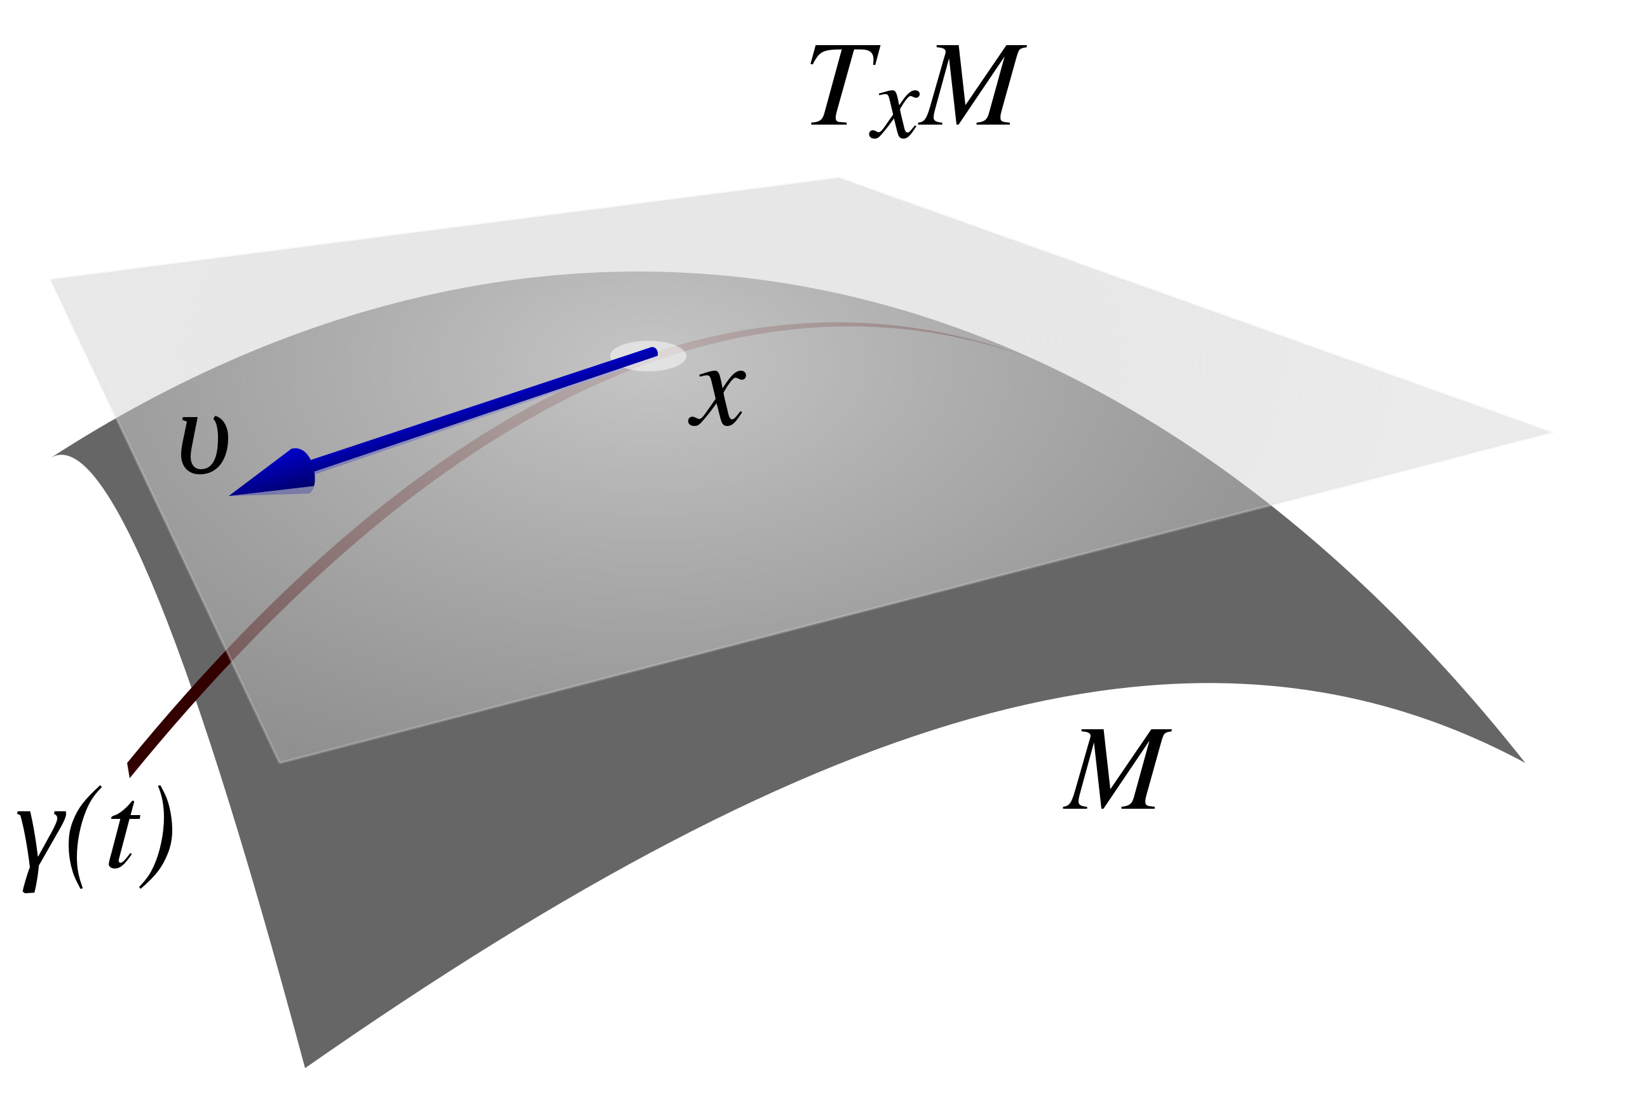
What is a tangent vector to a manifold?
At each point of the smooth manifold, we define a linear space of tangent vectors.
Rough idea: tangent vector is a derivative of a curve.
The image has been released into the public domain.

Slide 7
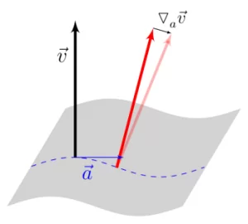
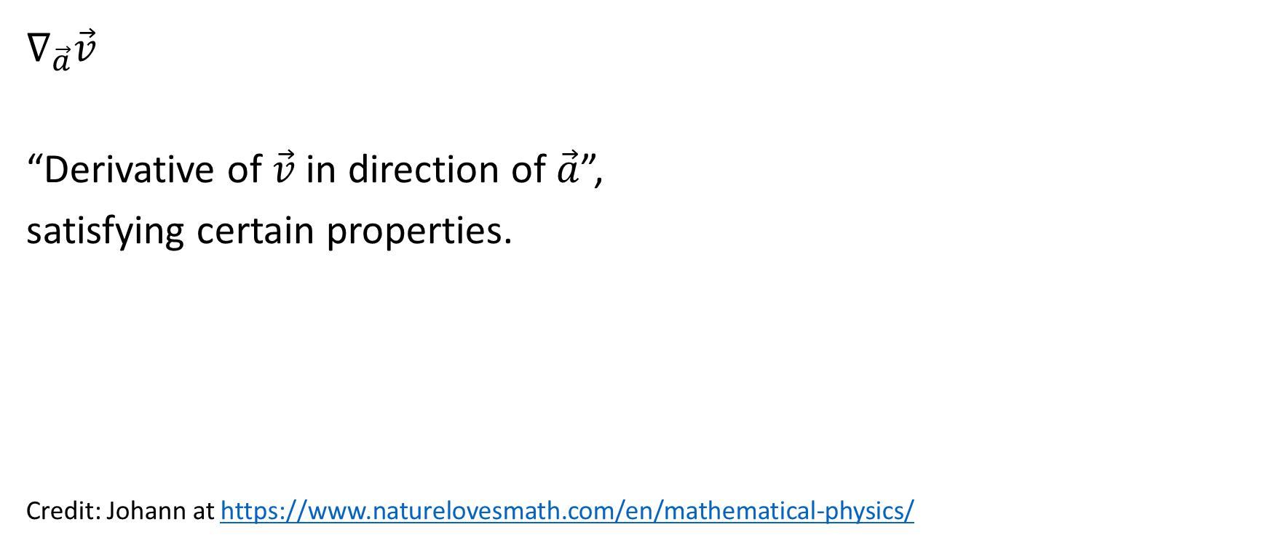
What is a covariant derivative?
$$∇_{\vec{a}}\vec{v}$$
“Derivative of $\vec{v}$ in direction of $\vec{a}$”,
satisfying certain properties.
Credit: Johann at https://www.naturelovesmath.com/en/mathematical-physics/

Slide 8
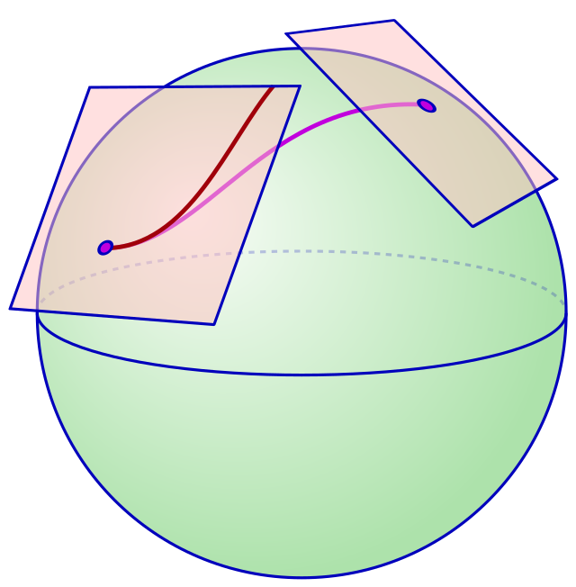
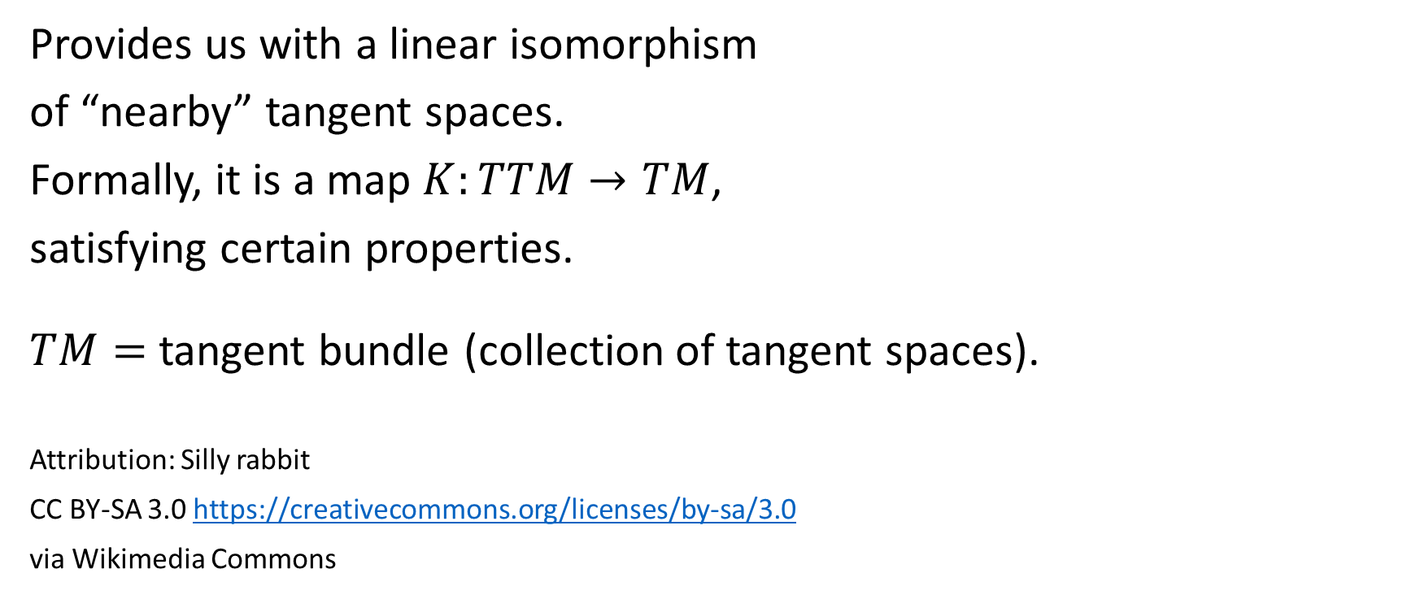
What is a connection?
Provides us with a linear isomorphism
of “nearby” tangent spaces.
Formally, it is a map $K:TTM→TM$,
satisfying certain properties.
$TM=$ tangent bundle (collection of tangent spaces).
Attribution: Silly rabbit
CC BY-SA 3.0 https://creativecommons.org/licenses/by-sa/3.0
via Wikimedia Commons

Slide 9
Main result of the thesis
“Giving a covariant derivative on a manifold is equivalent to giving the means of parallel transport—connection form—on said manifold.”

Slide 10
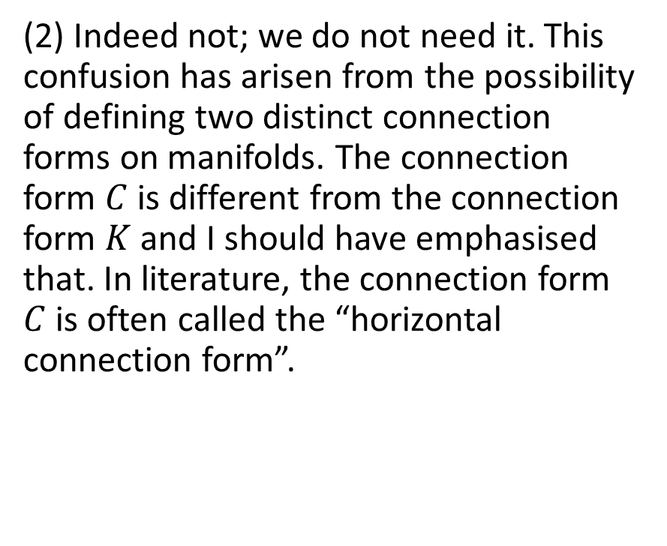
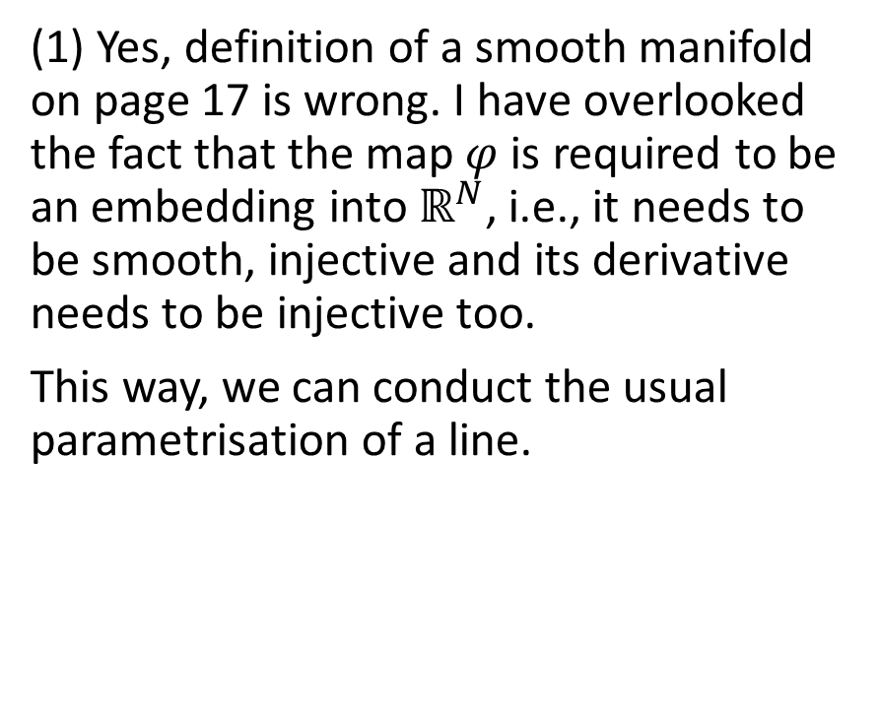
Questions raised in opponent’s report
(1) Yes, definition of a smooth manifold on page 17 is wrong. I have overlooked the fact that the map $φ$ is required to be an embedding into $ℝ^{N}$, i.e., it needs to be smooth, injective and its derivative needs to be injective too.
This way, we can conduct the usual parametrisation of a line.
(2) Indeed not; we do not need it. This confusion has arisen from the possibility of defining two distinct connection forms on manifolds. The connection form $C$ is different from the connection form $K$ and I should have emphasised that. In literature, the connection form $C$ is often called the “horizontal connection form”.

Slide 11
Thank you for your attention

